Slide 1

Department of Information Technology
A.P. Shah Institute of Technology
G.B.Road,Kasarvadavli, Thane(W), Mumbai-400615
UNIVERSITY OF MUMBAI
Academic Year 2019-2020

Slide 2
A Project Report on
Autonetics and Administration for IT Laboratories
Submitted in partial fulfillment of the degree of
Bachelor of Engineering(Sem-8) in
INFORMATION TECHNOLOGY
By
Karthikeyan (16104050)
Uddhabendra Maity (16104062)
Atharv Shetty (16104061)
Under the Guidance of
Dr. Sameer Nanivadekar
Prof. Vishal Badgujar

Slide 3
PRESENTATION FLOW
Abstract
Problem Definition
Objective
Introduction
Literature Survey
Project Timeline Chart
Theory (Proposed work/Implementation/Diagrams etc.)
Conclusion
Future Scope
References
Publication

Slide 4
ABSTRACT
Majority of IT labs in today's academic institutions face operational issues in the management of multiple systems simultaneously. The best example would be when a particular software needs to be installed in the labs, it becomes a tedious and time consuming process for the lab assistant to manually install the software in each and every system in the lab.
Also in some cases where the students forget to shutdown their respective computers, it becomes the responsibility of the lab assistant to shutdown the PCs manually. These challenges cause lack of access control and inadequate security. Moreover, there is lot of work pressure which leads to sub-optimal work schedules. To keep track of access records of the systems, we would also be designing a web-based GUI which records and displays the access information of PCs too.

Slide 5
PROBLEM DEFINITION
In current labs of university most of the administrative
work is done manually which consumes lot of time and efforts.
With the help of Ansible framework and a proper supporting
GUI which can unleash and maximize the full potential of the
servers, many of the current lab administrative problems can be
resolved.

Slide 6
OBJECTIVES
• To Automate the Software installation process.
• To Automate the PC shutdowns.
• To regulate the user identity of every PC along with time in
a digital format.
• To create a GUI for authorized & effortless execution
of playbooks.
• To unleash the full potential of Ansible for IT automation.

Slide 7
INTRODUCTION
As we are using a free and open-source platform for our purpose, many labs can be automated using the same architecture at a very feasible price.
Ansible provides the automation of IT infrastructure which includes – creation of virtual machine, installation of new softwares, Docker containers.
We can configure our own cluster and make it up and running without any sort of human intervention. Ansible does its work like a professional if customized with proper facts and experience.
Ansible works over SSH ensure that the target Machine or Server is accessible over SSH. It supports all type of SSH authentication.

Slide 8
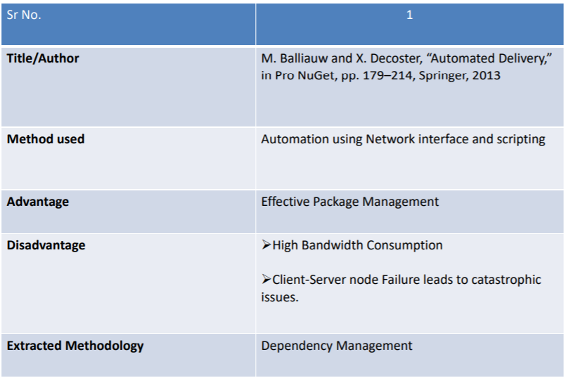
LITERATURE SURVEY

Slide 9
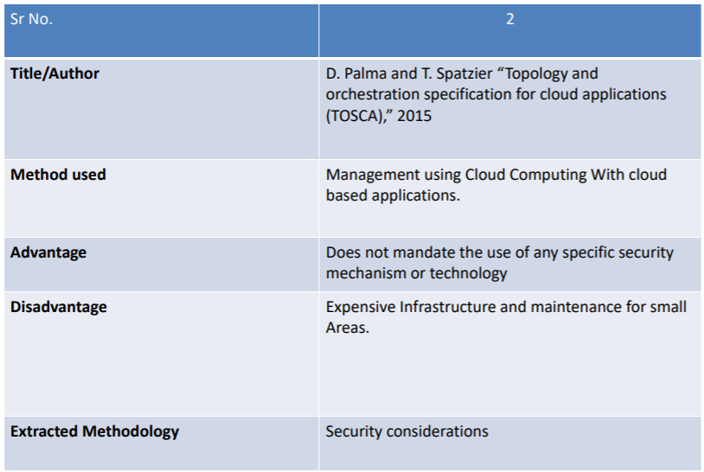

Slide 10
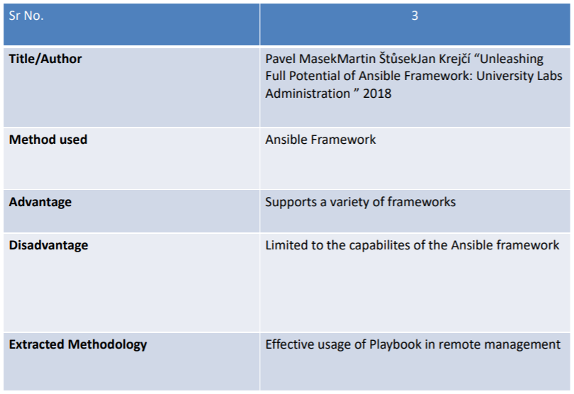

Slide 11
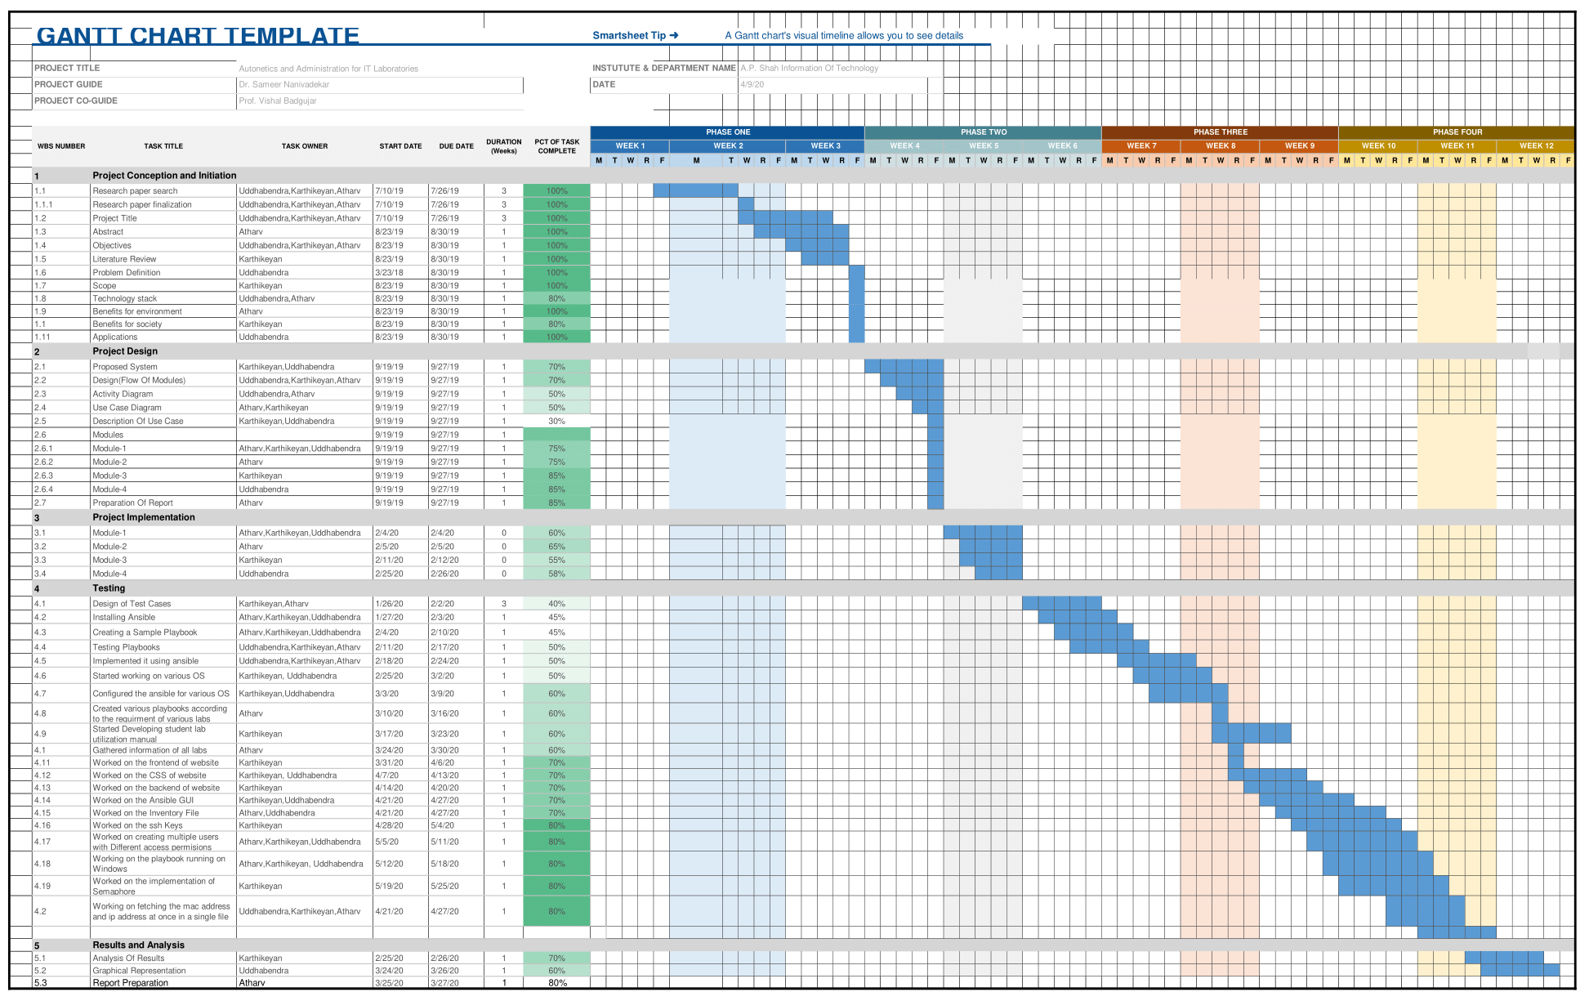
Project Timeline Chart

Slide 12
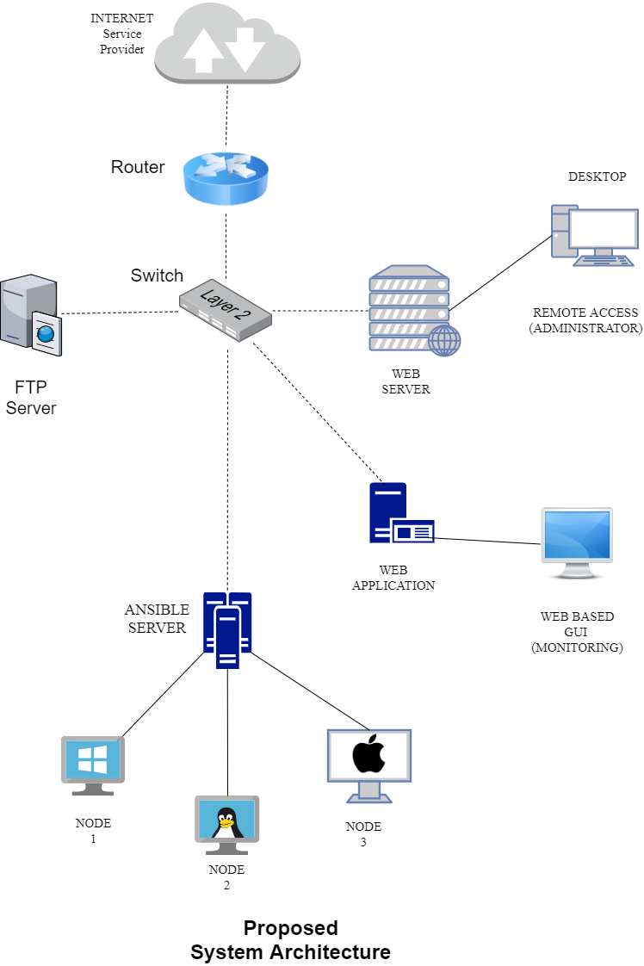
PROPOSED ARCHITECTURE

Slide 13
TECHNOLOGY STACK
• Ansible tool is used in our project
• Ansible server is used for hosting the web application
• Database: MariaDB
• Nodes will be Linux, Ubuntu, Windows
• Front End: Semaphore, Python, HTML5

Slide 14
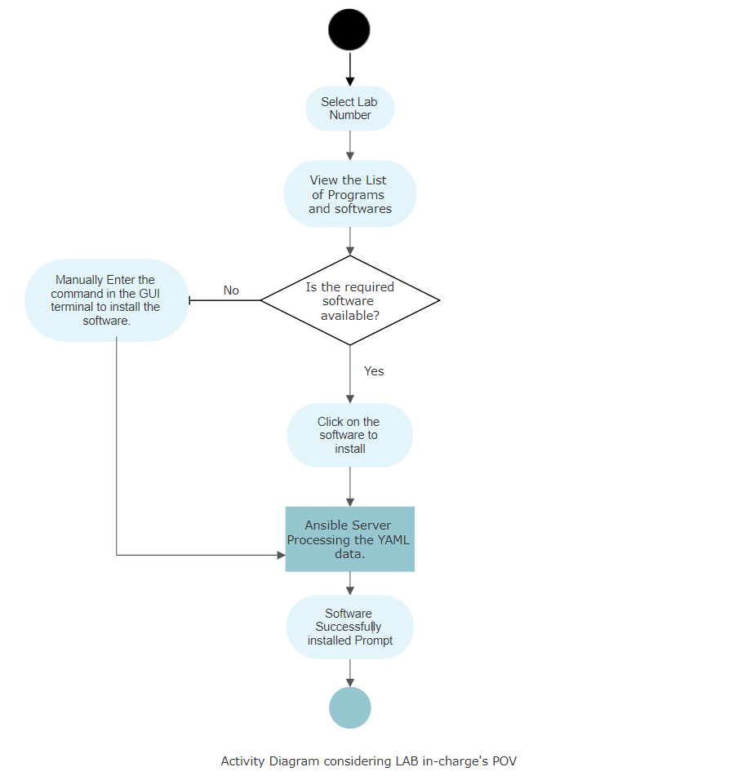
ACTIVITY DIAGRAM
Lab in-charge’s perspective

Slide 15
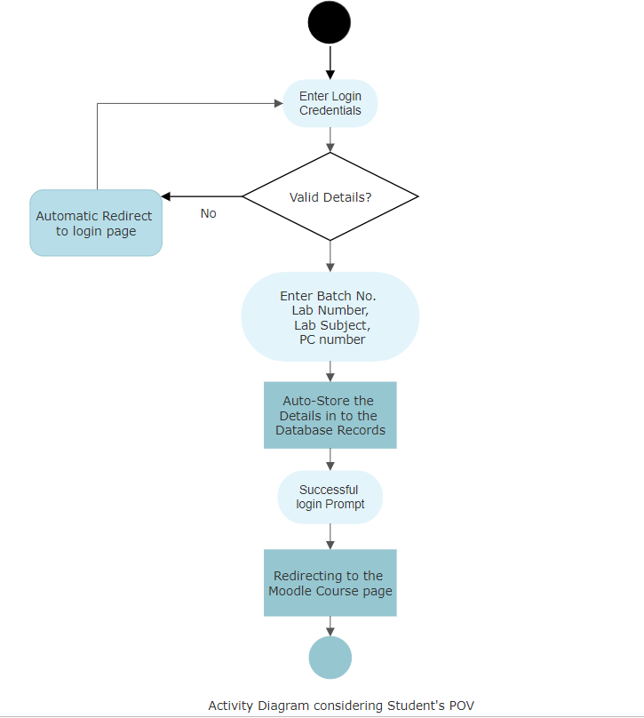
ACTIVITY DIAGRAM
Student’s perspective

Slide 16
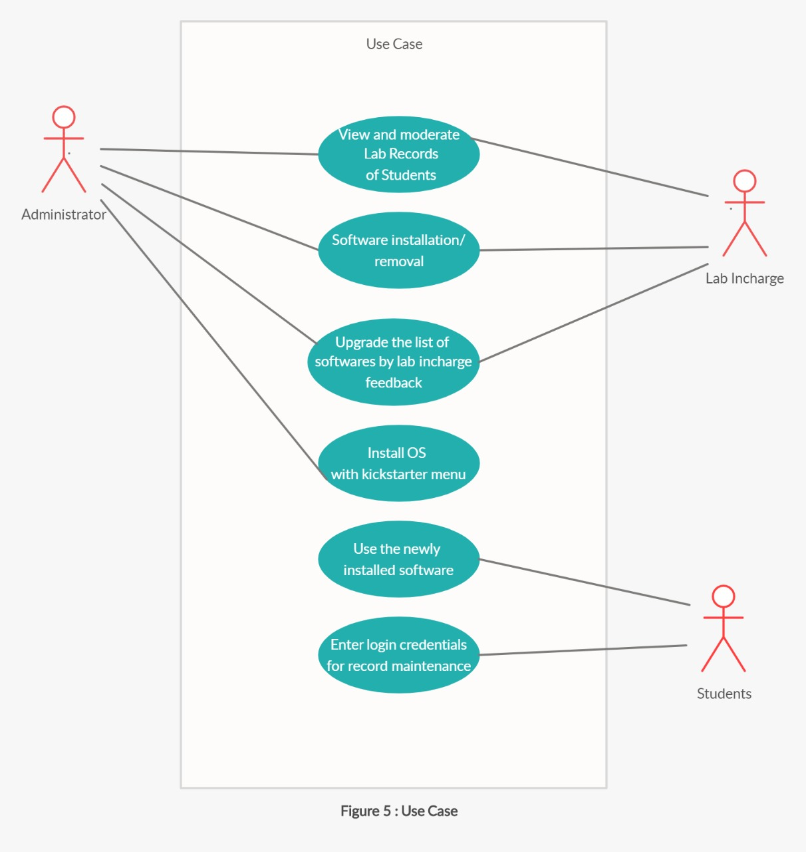
USE CASE DIAGRAM

Slide 17
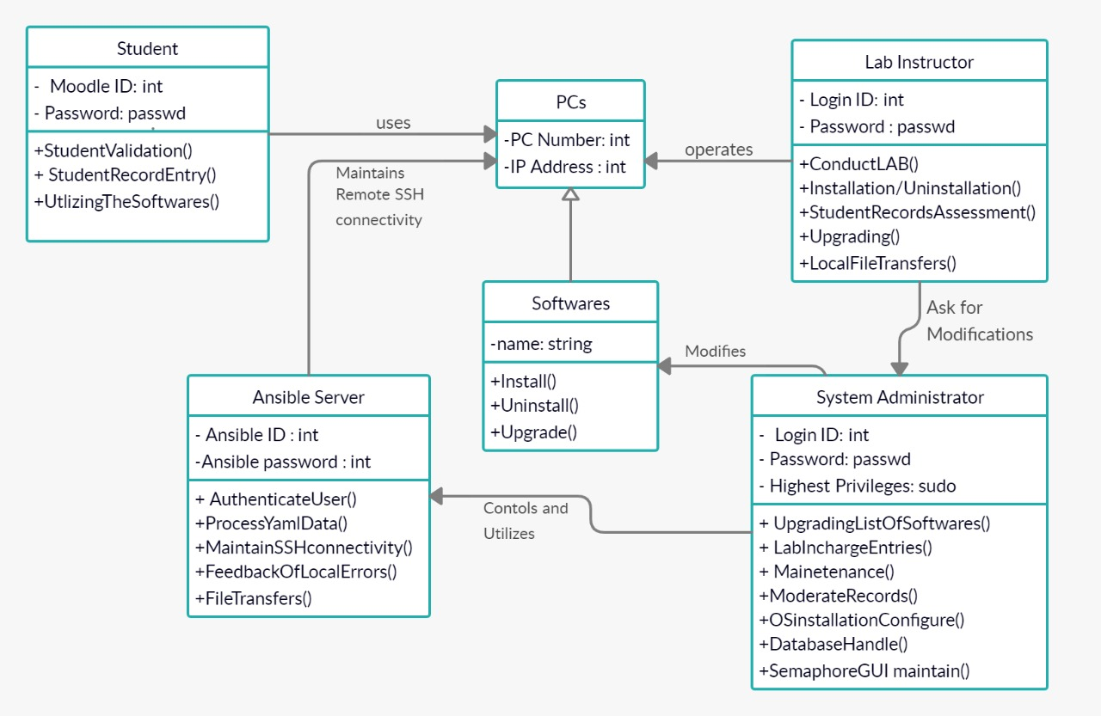
CLASS DIAGRAM

Slide 18
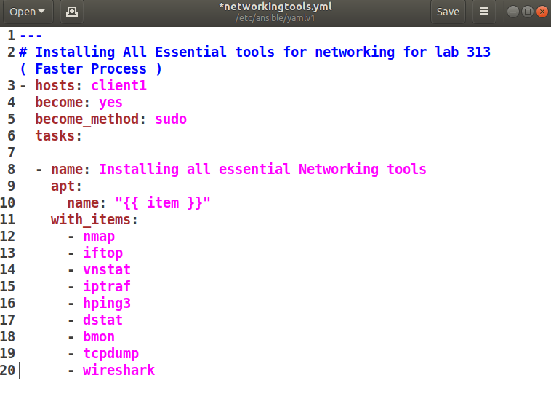
IMPLEMENTATION
Sample playbook for installing the essential set of tools for networking
in a college laboratory infrastructure:-

Slide 19
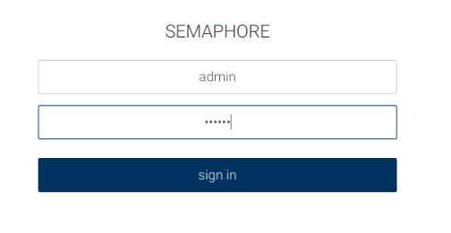
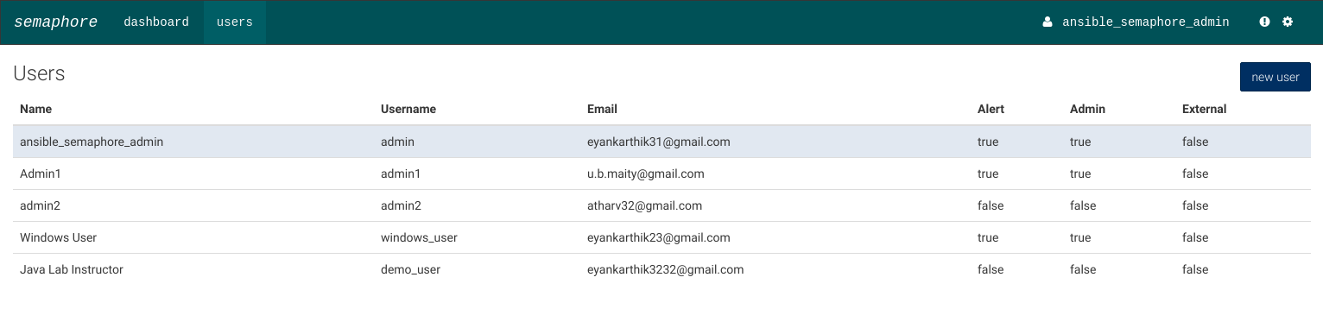
Ansible login GUI for LAB instructors
User Manager for Admins

Slide 20
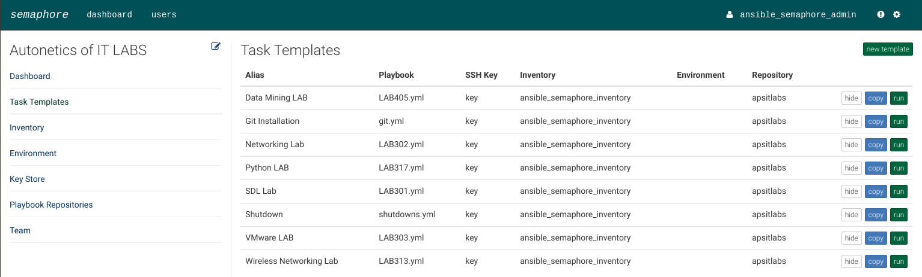
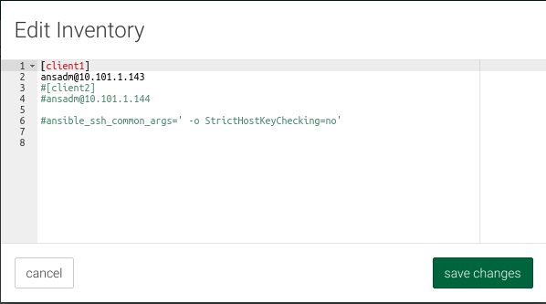
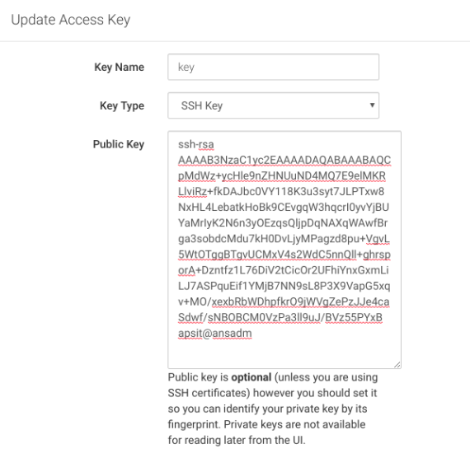
Playbooks for different LABS
Inventory file
SSH access keys

Slide 21
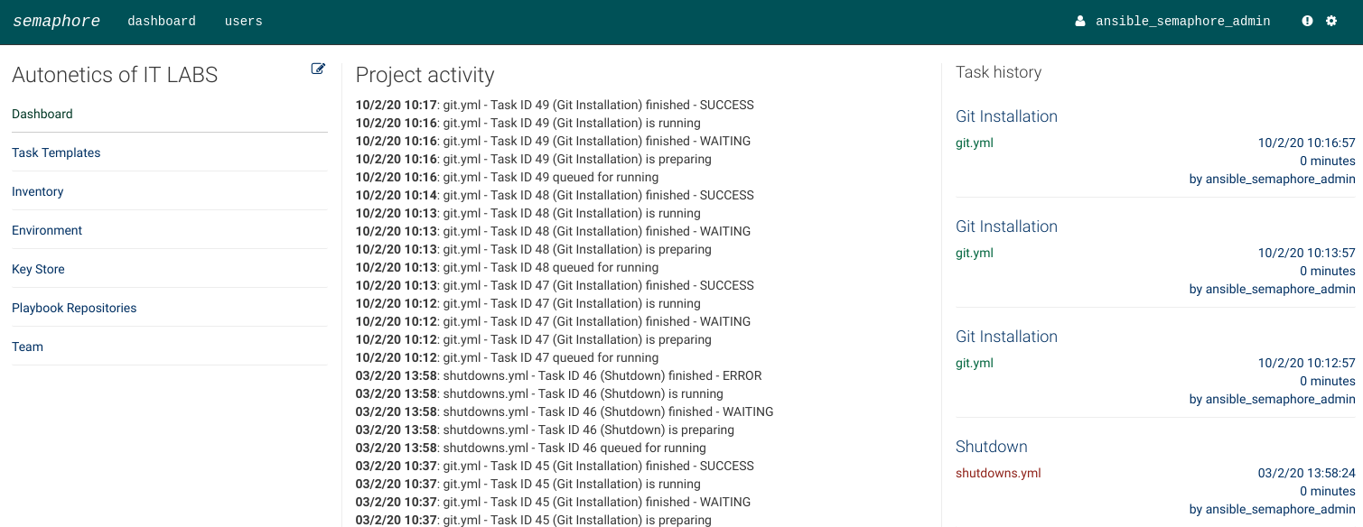
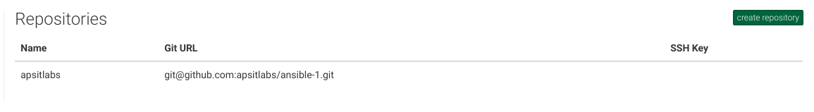
Realtime Log generation
Fetching from Github Repository

Slide 22
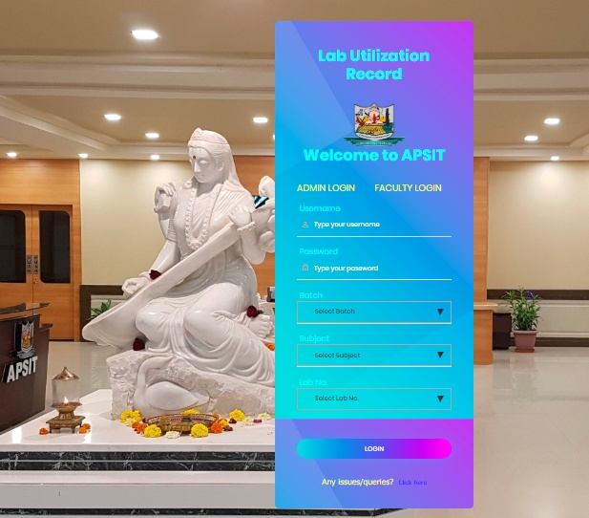
Student Lab Utilization Record

Slide 23
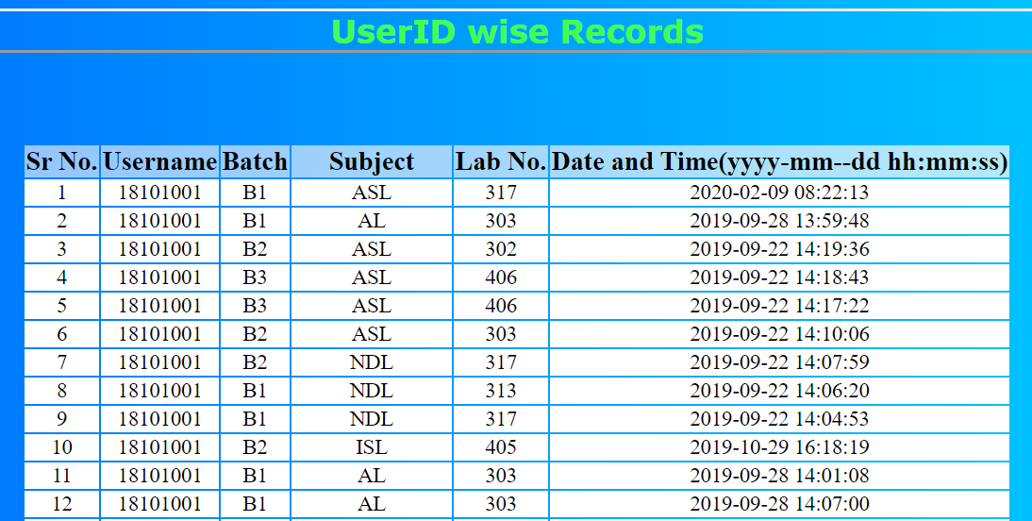
Centralized monitoring of lab utilization logs

Slide 24
CONCLUSION
The main motive of our work is to create a trustworthy, efficient and real-time system for administration of IT labs in universities. Now all the administrative tasks inside the lab can be executed at a very minimal time and effort with our system. The overall purpose was to minimize the efforts and ensure rapid deliveries of the needed softwares through automation. These objectives have been checked successfully and we hope to enhance the system furthermore and increase the advancements in our system. Thus we are making an effort to implement this system in the current university labs and modernize the IT labs methodically.

Slide 25
FUTURE SCOPE
Integration of IOT : We plan to integrate IOT interfaces in our system for controlling all the electrical appliances throughout the lab remotely.
Using Docker containers for easy deployment of applications in real time.
Enhancing centralized administration : Providing real time log generation to the system administrators for moderating the student's usage during exams or placements.

Slide 26
REFERENCES
[1] Xavier Decoster and Maarten Balliauw“Automated Delivery in Pro Nuget” October 2016.
[2] D.Palma and T.Spatzier. December 2016 “Topology and orchestration specification for cloud applications (TOSCA) ” November 2013
[3] Pavel MasekMartin and ŠtůsekJan Krejčí, “Unleashing Full Potential of ansible Framework: University Labs Administration” May 2018

Slide 27
PUBLICATION
Paper entitled “Autonetics and Administration for IT Laboratories” has been presented in “IEEE International Conference on Convergence to Digital World – Quo Vadis (ICCDW 2020)” by Karthikeyan Venkatachalam, Uddhabendra Maity, Atharv Shetty,
Dr. Sameer Nanivadekar and Mr. Vishal Badgujar .

